Slide 1

Baseball Box Score Statistics and WAR
By Tate Williams
SAL603

Slide 2
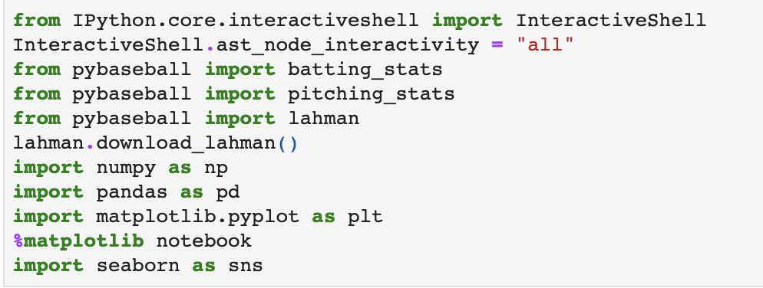
Imports

Slide 3
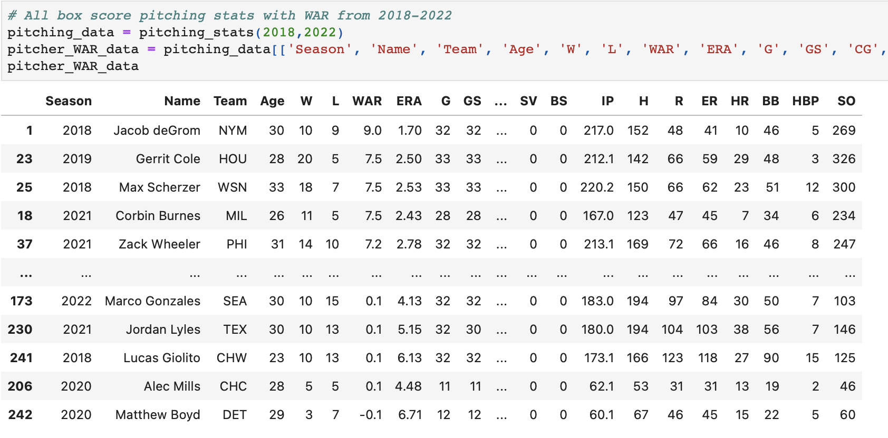

Slide 4
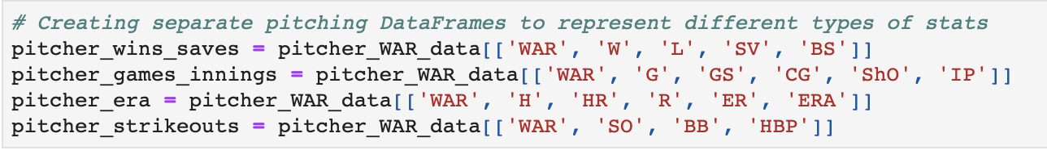
Pitcher Categorical DataFrames

Slide 5
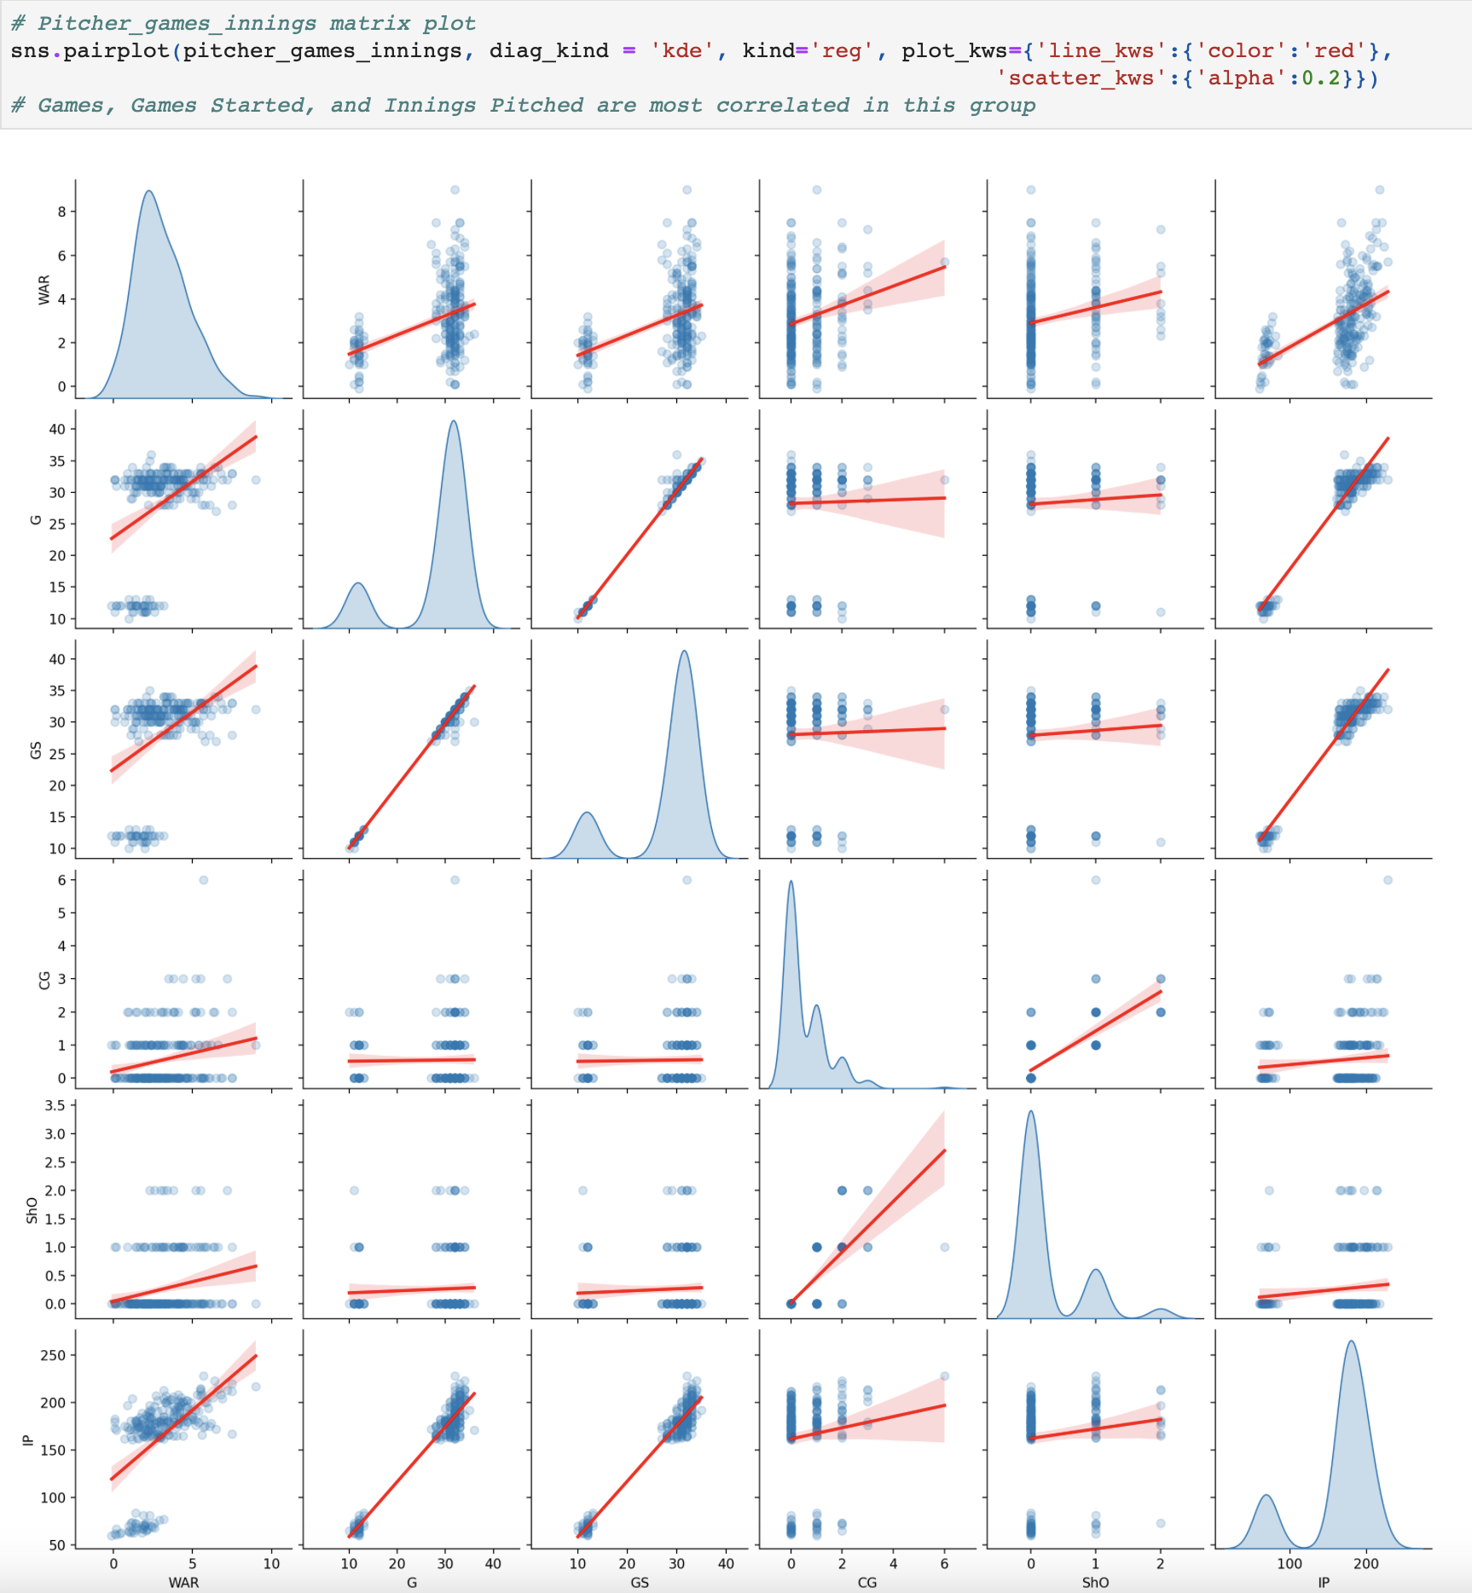
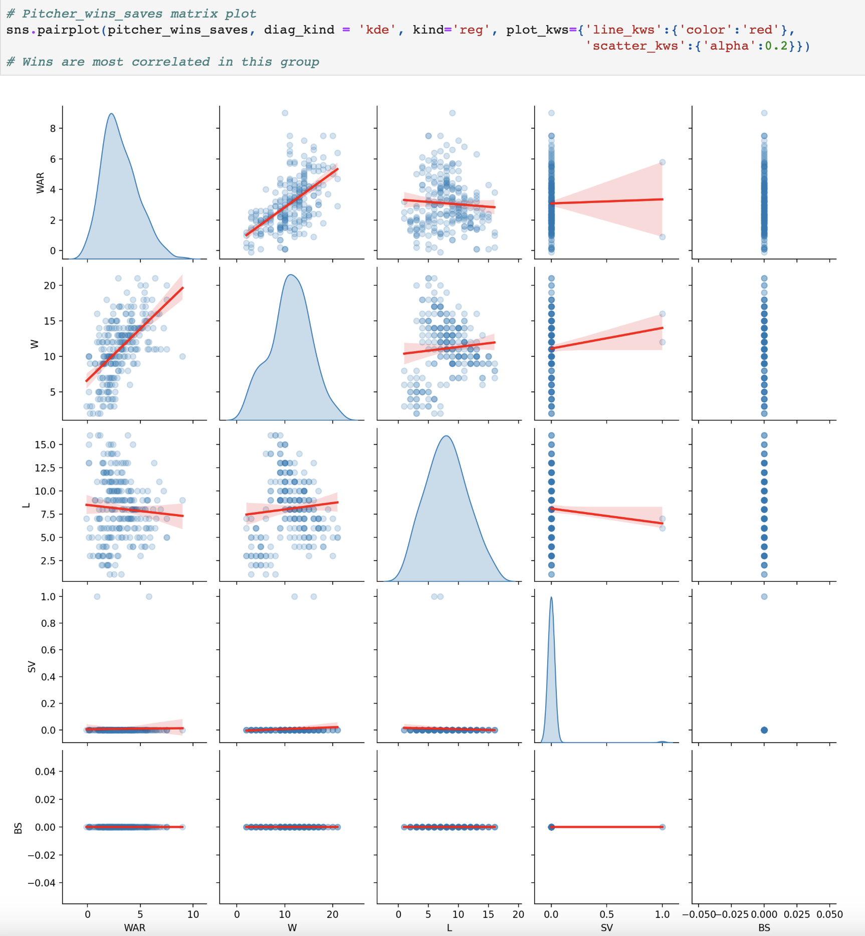
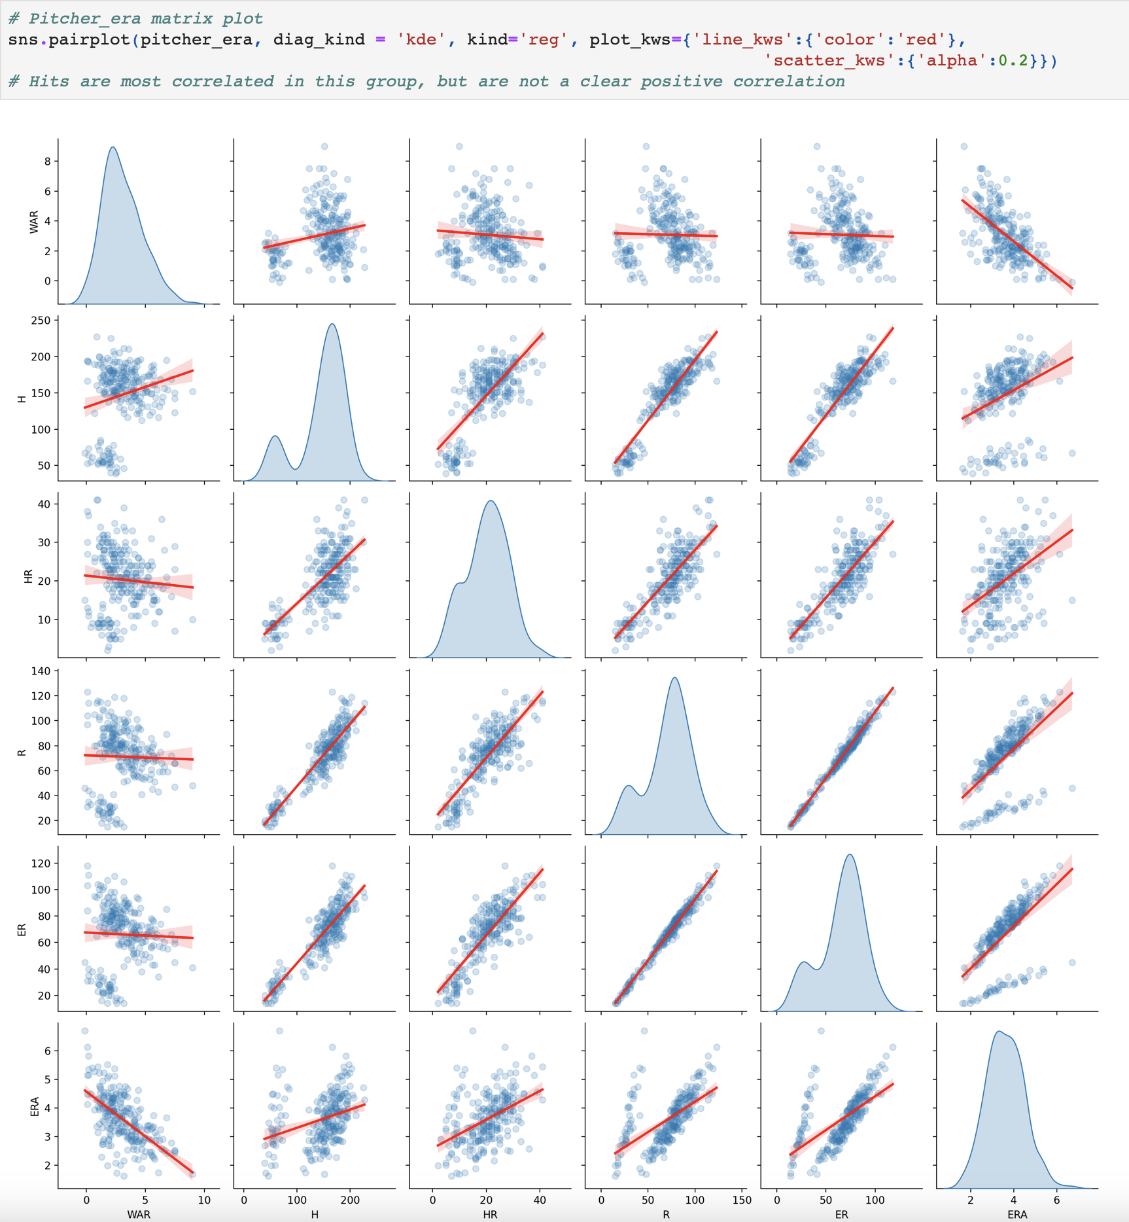
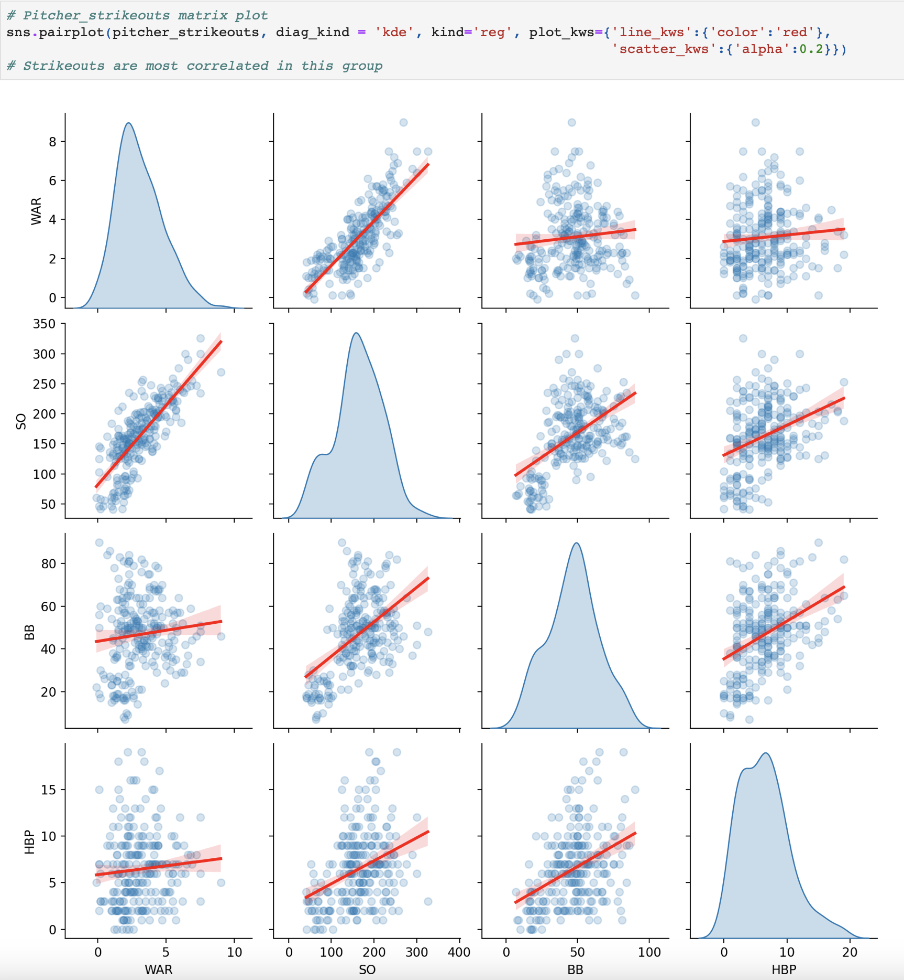
Matrix Plots
The most positively correlated with pitcher WAR were put into a new separate DataFrame.

Slide 6
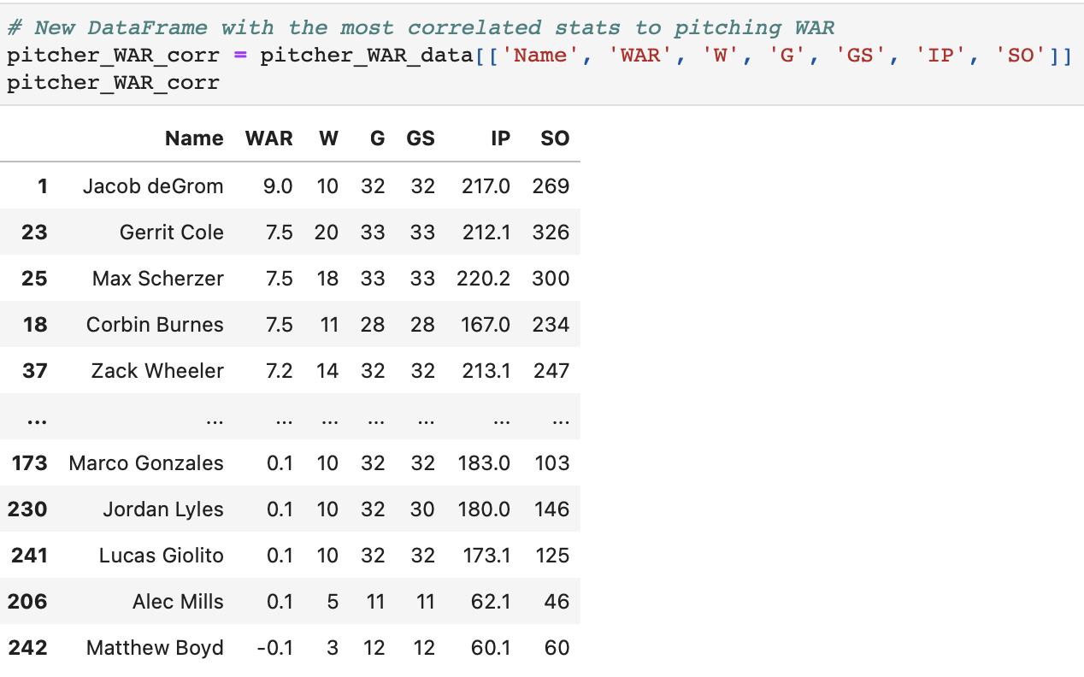
New DataFrame

Slide 7
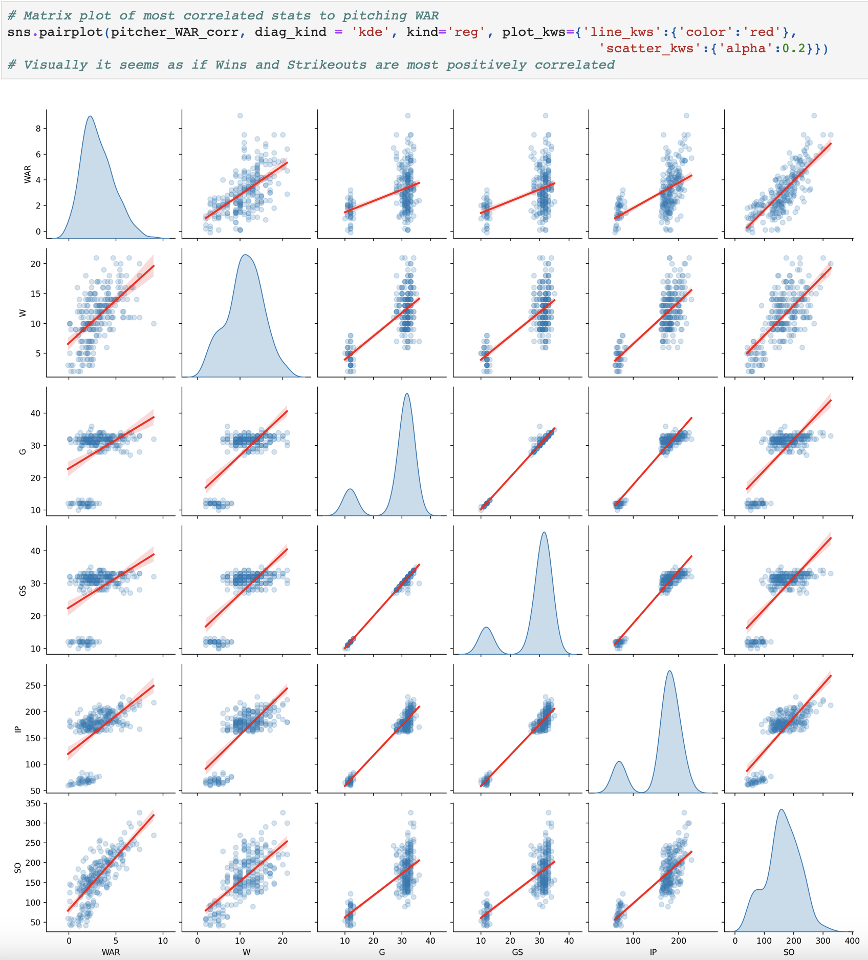
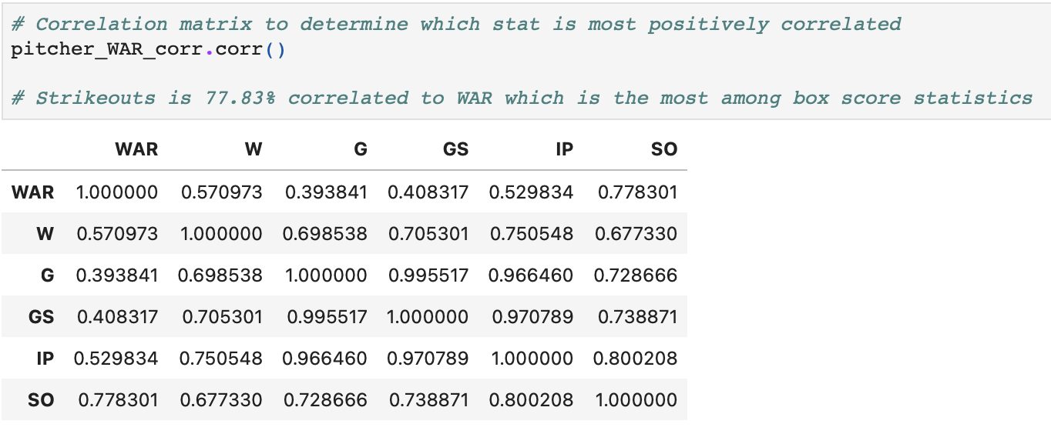
Conclusion for Pitcher WAR

Slide 8
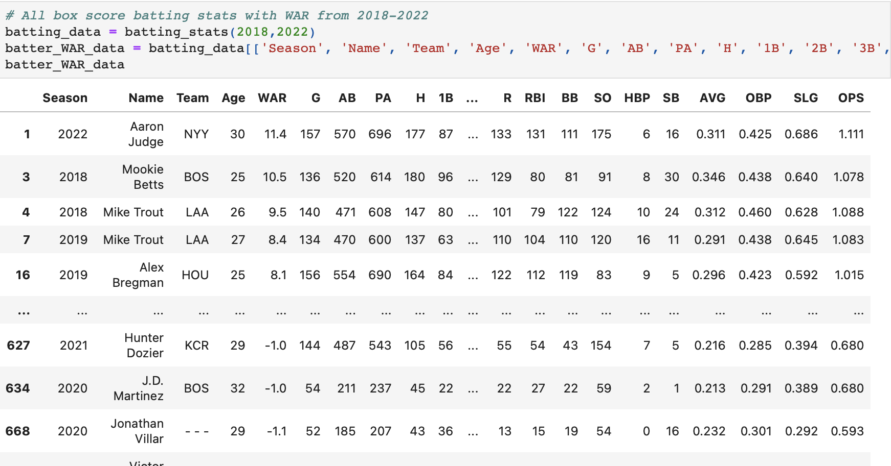

Slide 9
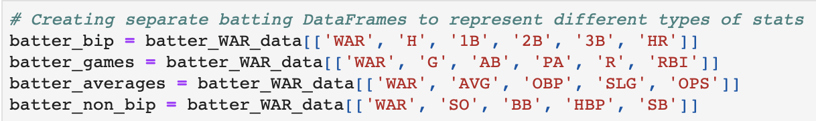
Batter Categorical DataFrames

Slide 10
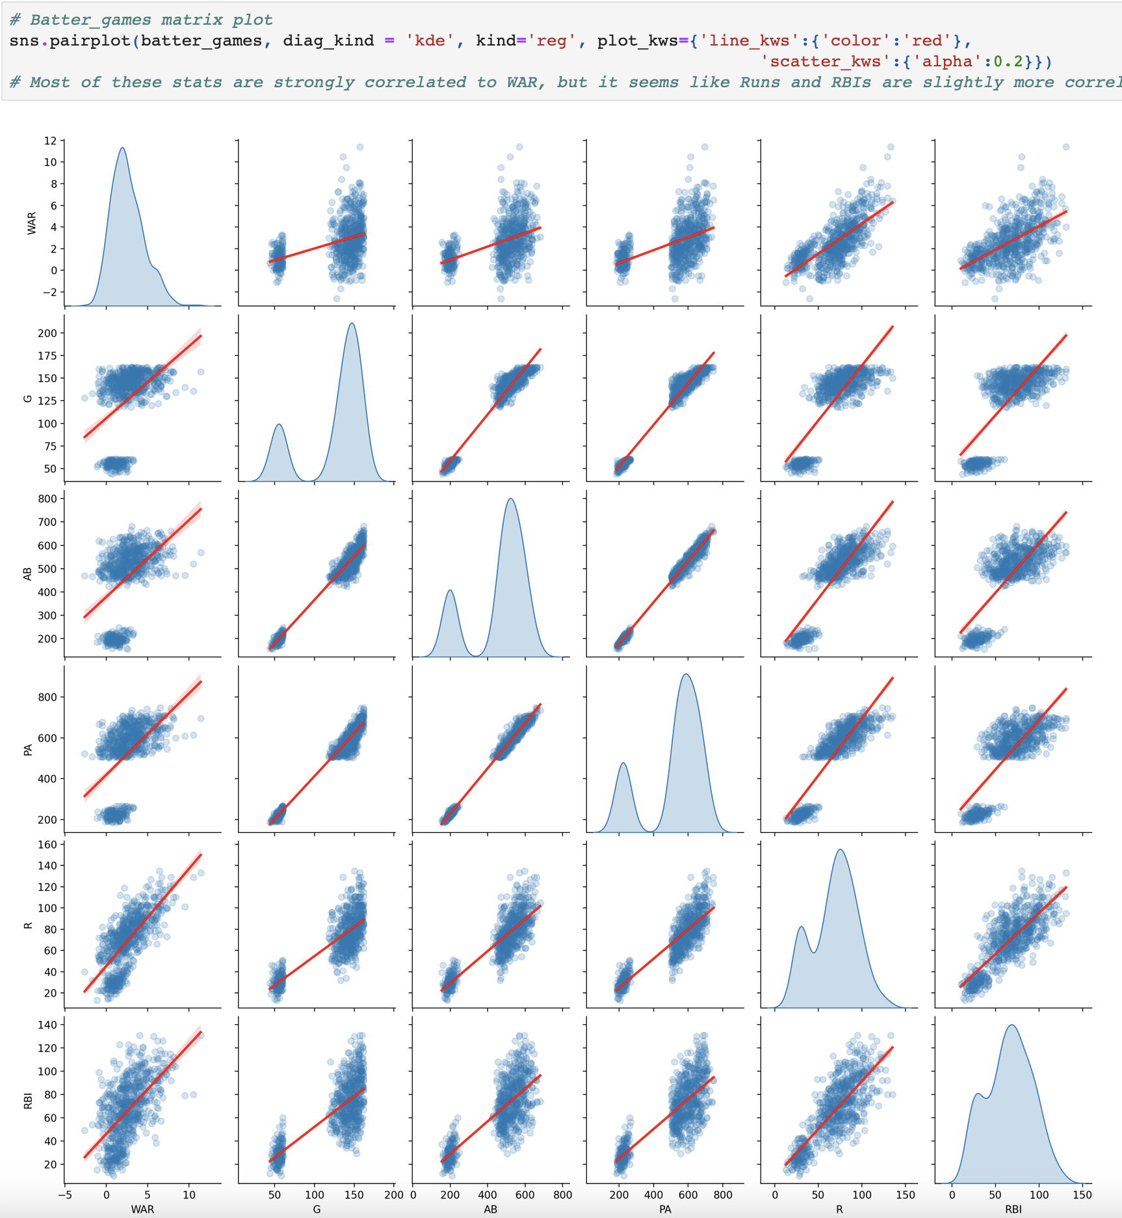
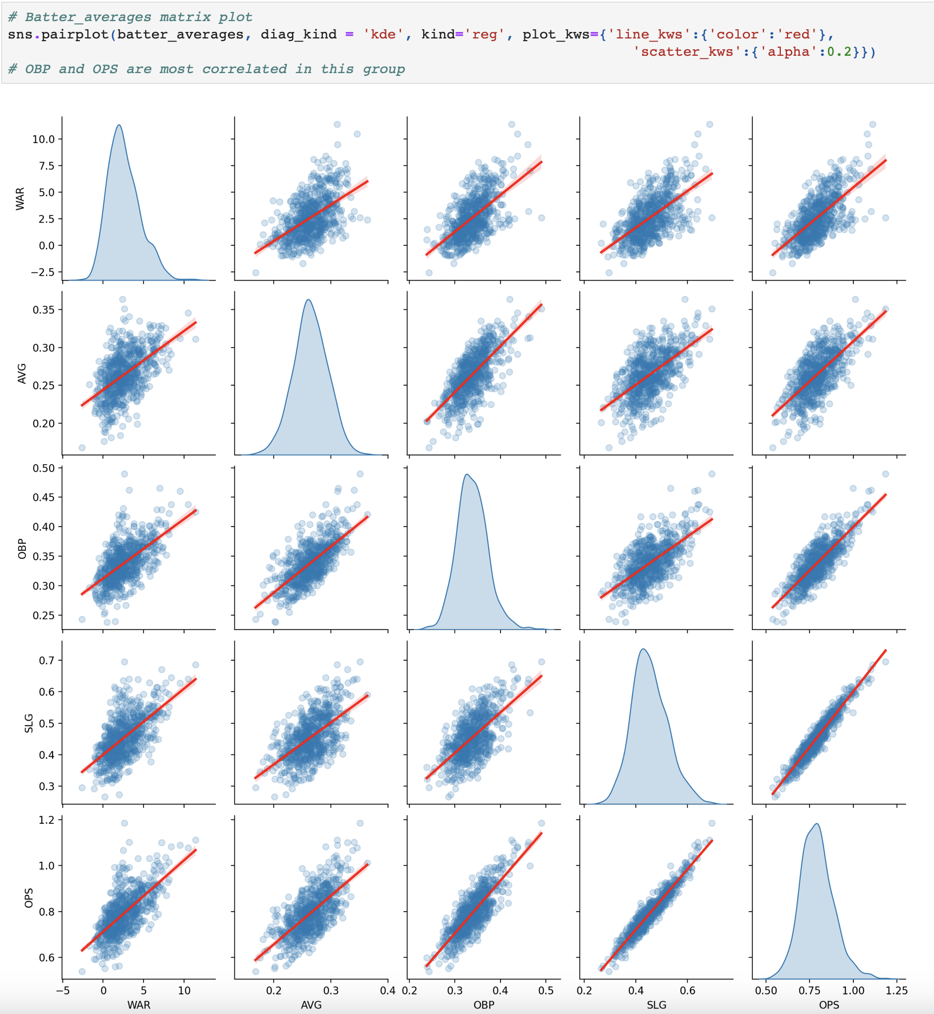
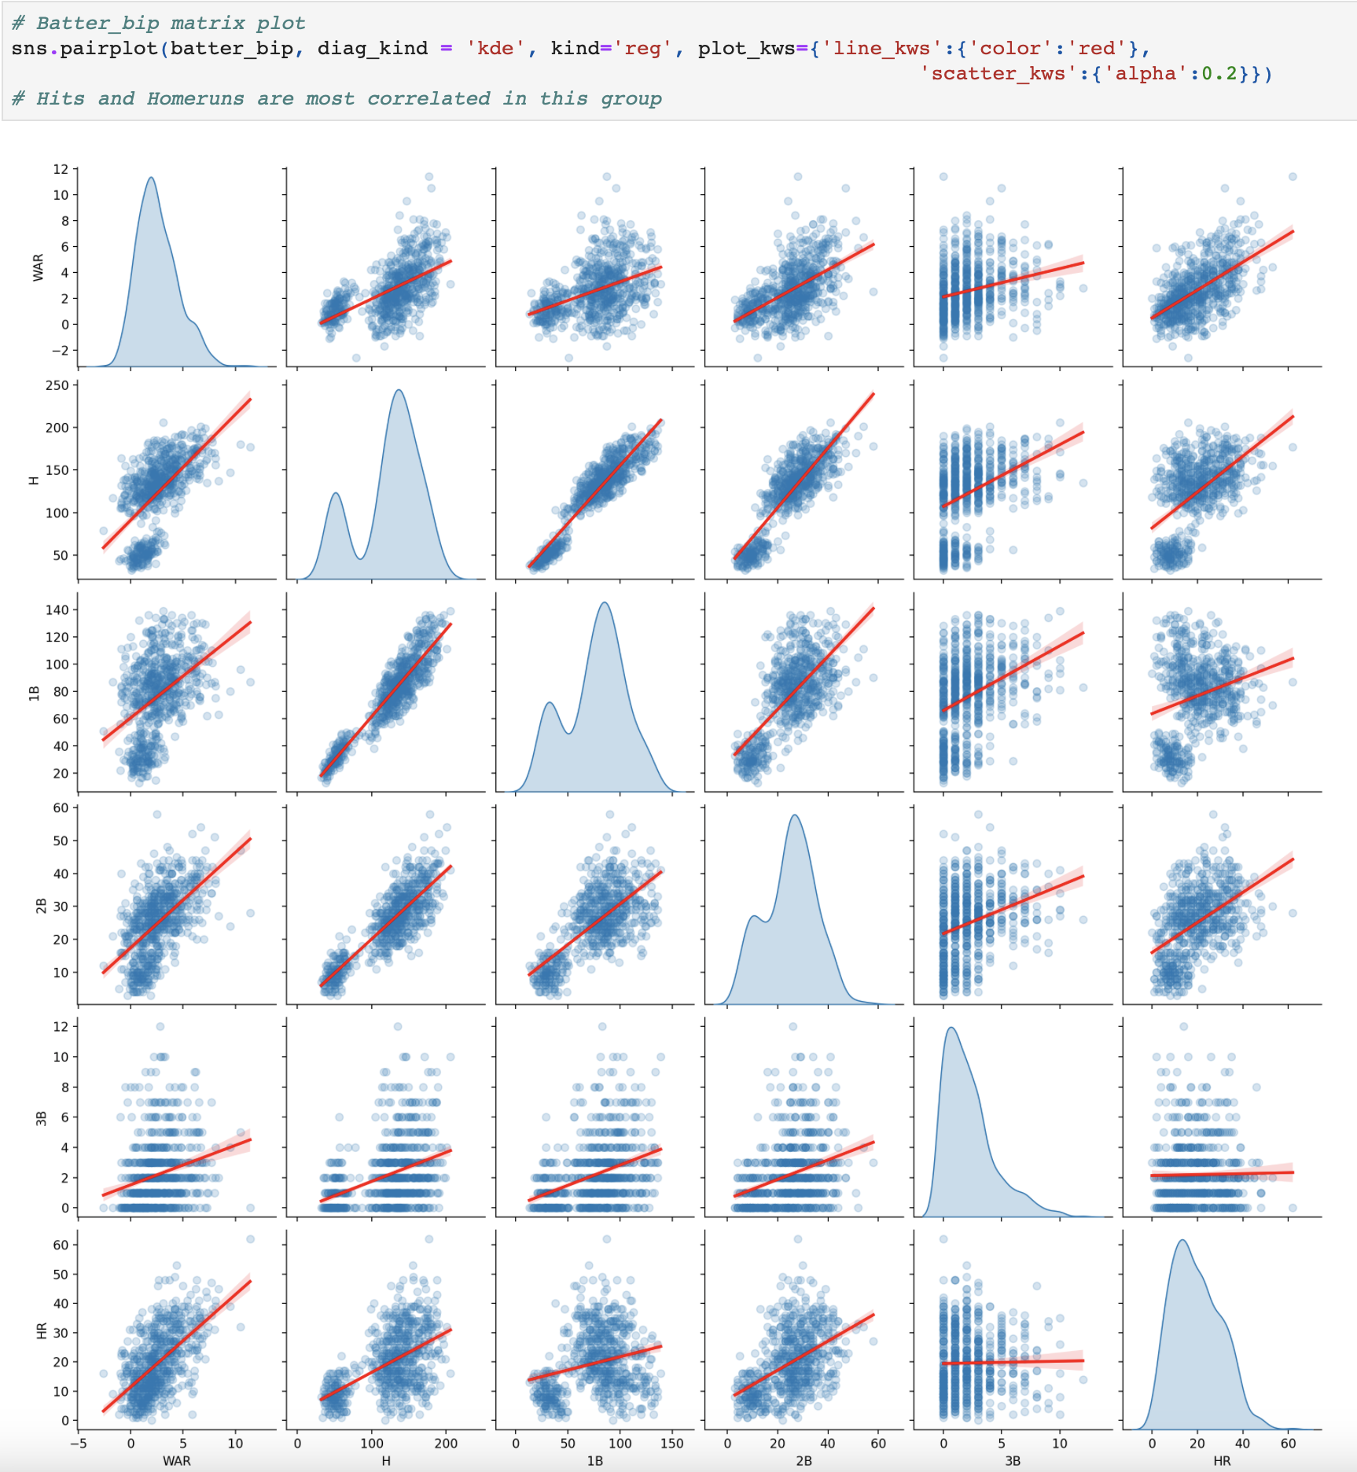
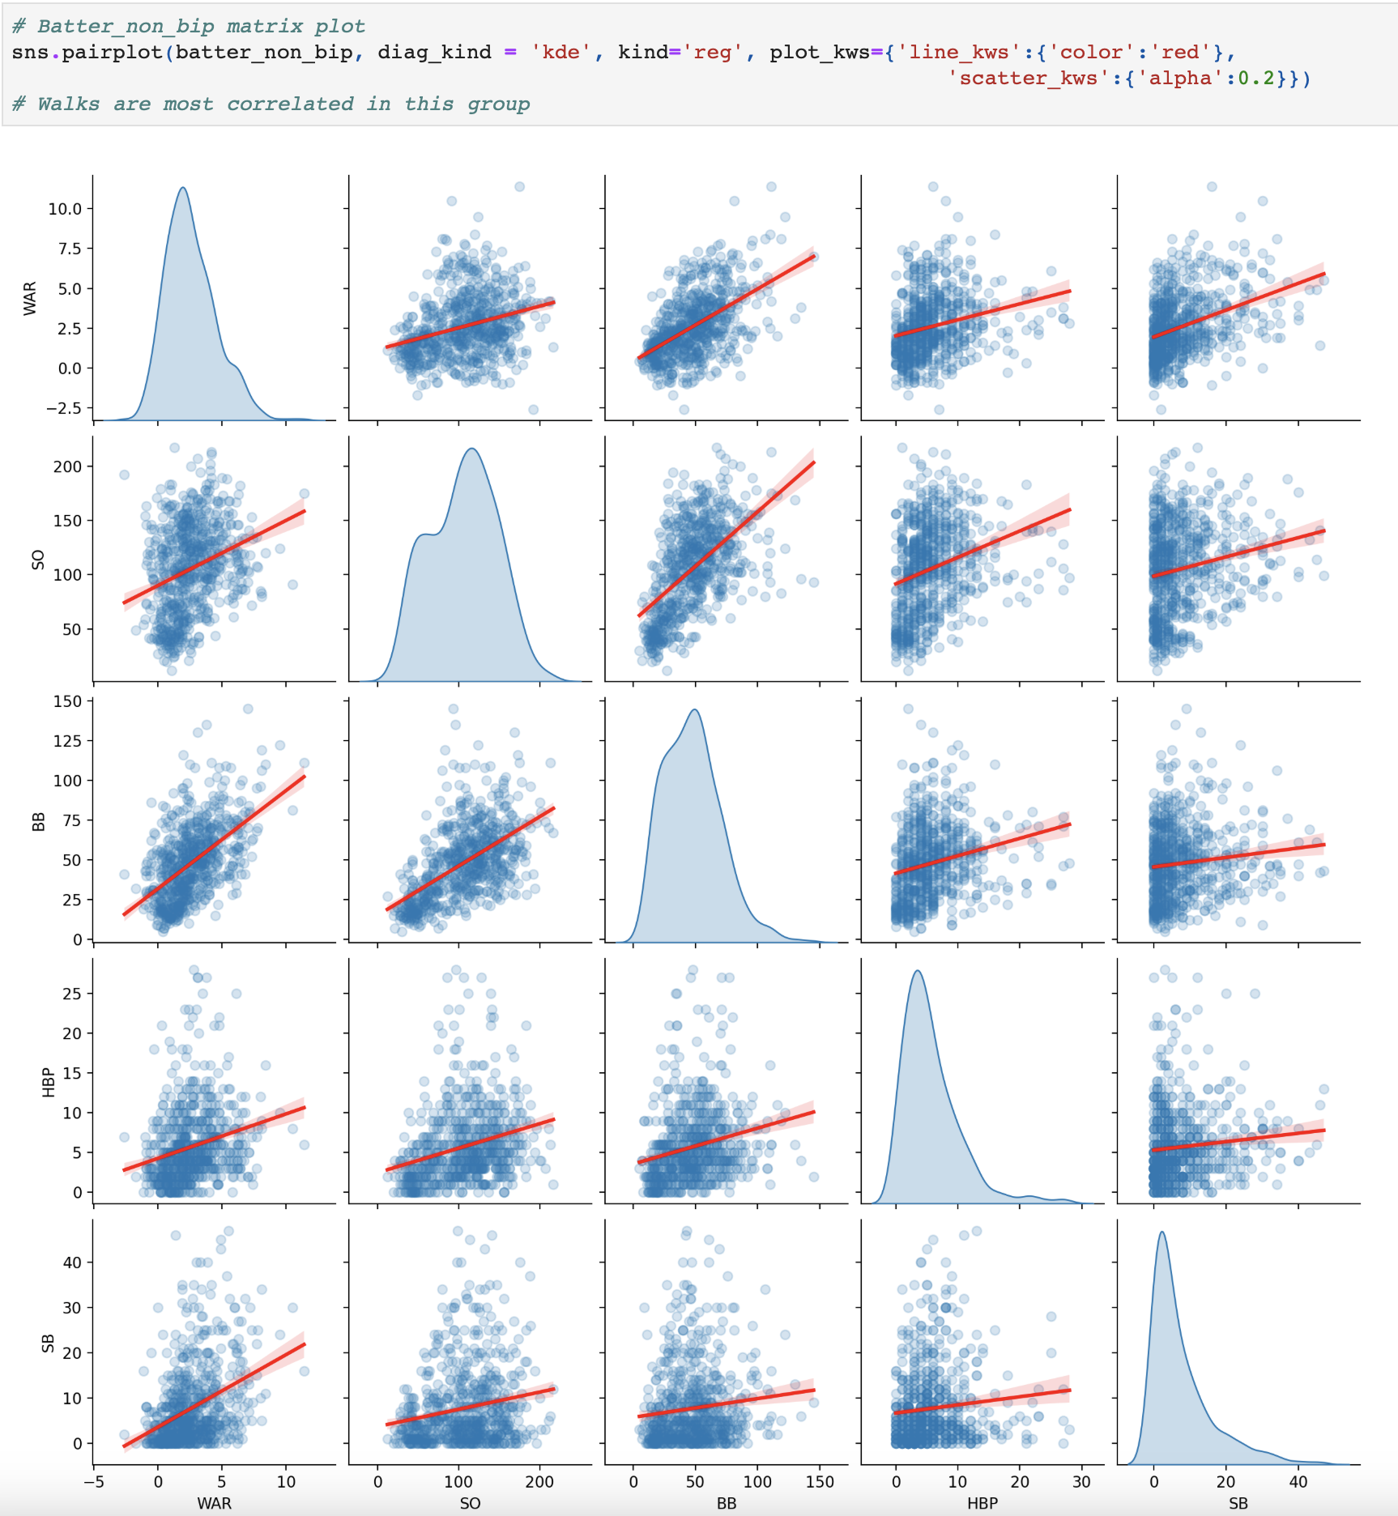
Matrix Plots
The most positively correlated with pitcher WAR were put into a new separate DataFrame.

Slide 11
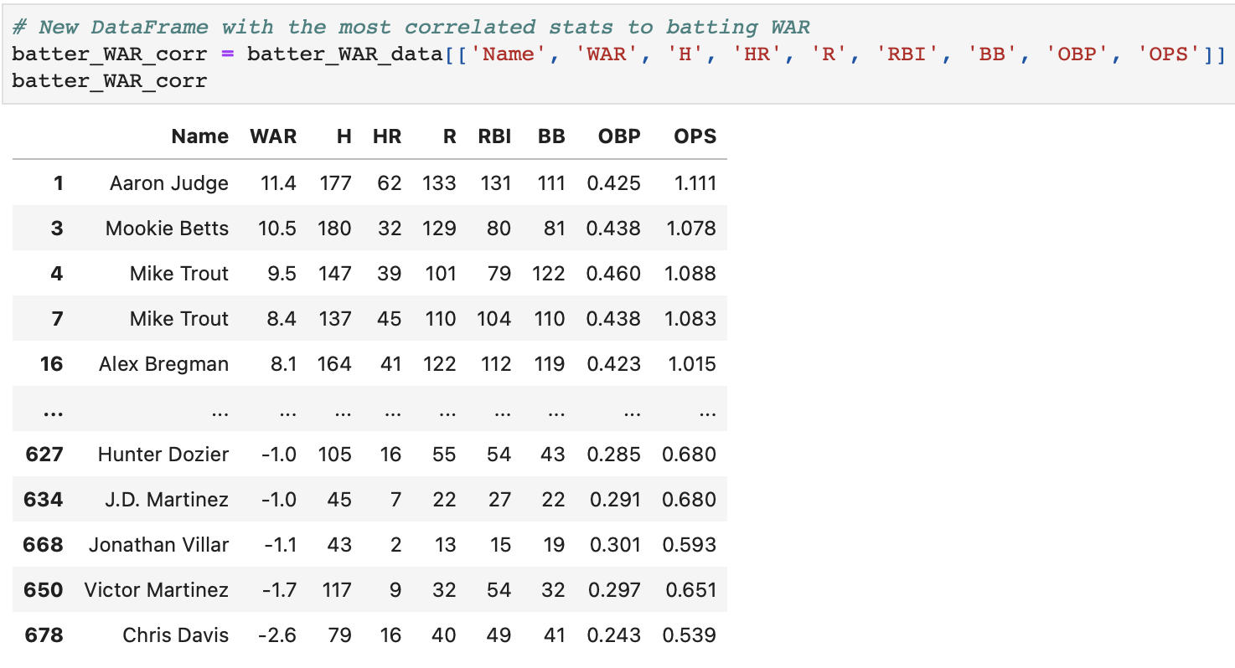
New DataFrame

Slide 12
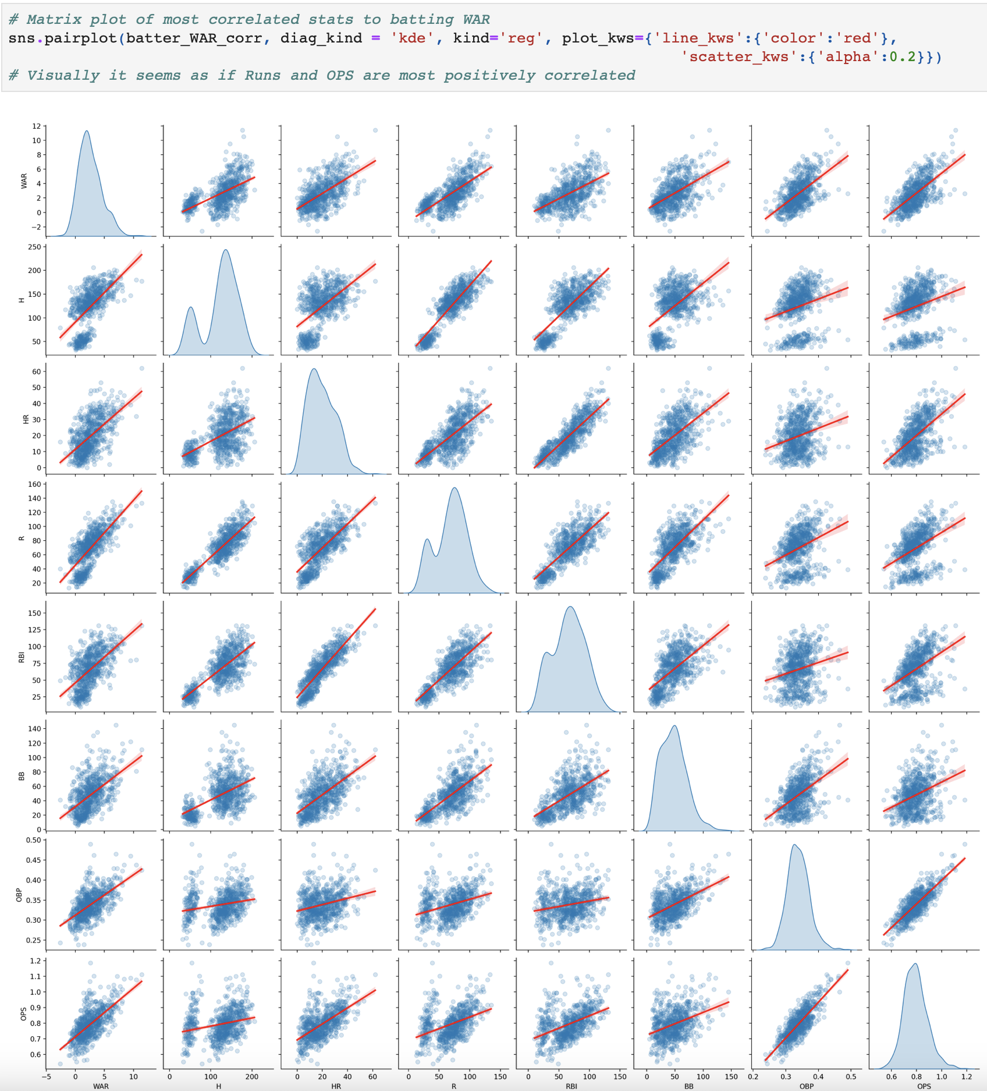
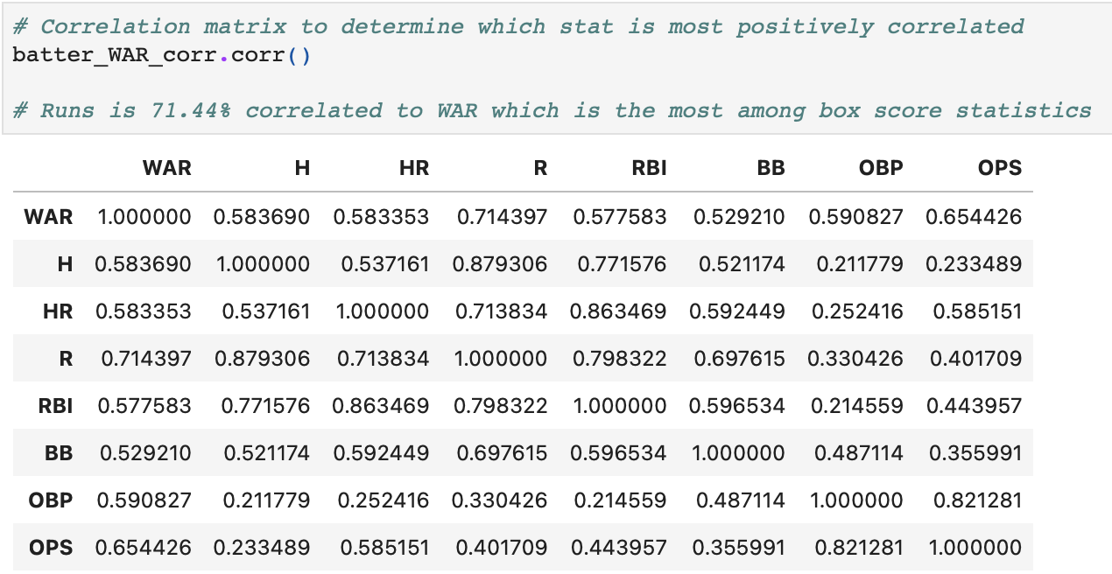
Conclusion for Batter WAR

Slide 13
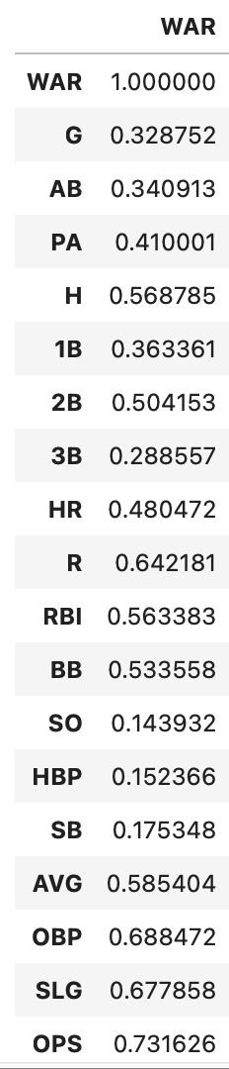
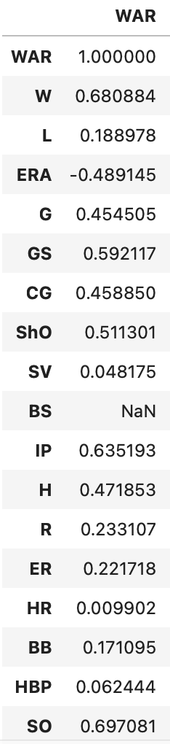
Comparing Correlation to WAR
Comparing statistics from 2018-2022 to 1871-2000.
Strikeouts still are most correlated to pitcher WAR.
OPS, OBP, and SLG are all more correlated than Runs for Batter WAR.

